Slide 1

Introduction to Computer Systems
CSIM601251
Slide By : Erdefi Rakun
Fasilkom UI

Slide 2
Outline
Reason why we need to learn computer system architecture
Level of abstraction
Great realities

Slide 3
WHY? (From USER To BUILDER)
You want to call yourself a computer scientist.
You want to build software people use.
You need to make purchasing decisions.
You need to offer “expert” advice.
Hardware and software affect performance
Algorithm determines number of source-level statements
Language, compiler, and architecture determine machine instructions
Processor and memory determine how fast instructions are executed
Understanding performance
Aaron Tan’s slide

Slide 4

Do You Know?
From a student’s feedback: “But I am not going to do any of the above. I’m not even going to be in Computer Science program. These are all irrelevant to me. So why must I learn all these?”
Aaron Tan’s slide

Slide 5
Outline
Reason why we need to learn computer system architecture
Level of abstraction
Great realities

Slide 6

Levels of Abstraction
Software
Application (IE, Excel, etc.)
Operating
System
(Windows XP)
Compiler
Assembler
Instruction Set
Architecture
Processor
Memory
I/O system
Datapath & Control
Computer Architecture
Hardware
Digital Design
transistors
Digital Logic Design
Aaron Tan’s slide

Slide 7
Levels of Abstraction
S/W and H/W consists of hierarchical layers of abstraction, each hides details of lower layers from the above layer
The instruction set arch. abstracts the H/W and S/W interface and allows many implementation of varying cost and performance to run the same S/W

Slide 8
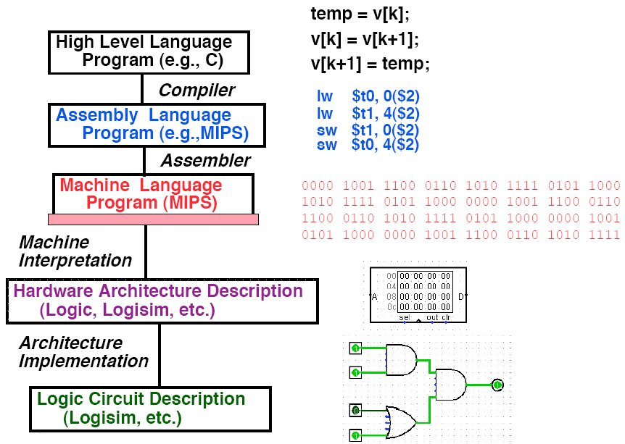
LEVELS OF REPRESENTATION
Aaron Tan’s slide

Slide 9
Abstraction is good, but don’t forget the reality
These abstractions have limits
Especially in the presence of bugs
Need to understand details of underlying implementations
Useful outcomes
Become more effective programmers
Able to find and eliminate bugs efficiently
Able to understand and tune for program performance
Prepare for later “systems” classes (Compilers, Operating Systems, Networks, Computer Architecture, Embedded Systems
Randall’s slide

Slide 10
Outline
Reason why we need to learn computer system architecture
Level of abstraction
Great realities

Slide 11
Great Reality #1
Int’s are not Integers, Float’s are not Reals
Examples
Is x² ≥ 0?
Float’s: Yes!
Int’s:
40000 * 40000 --> 1600000000
50000 * 50000 --> ??
Is (x + y) + z = x + (y + z)?
Unsigned & Signed Int’s: Yes!
Float’s:
(1e20 + -1e20) + 3.14 --> 3.14
1e20 + (-1e20 + 3.14) --> ??
Randall’s slide

Slide 12
Great Reality #2
You’ve got to know assembly
Chances are, you’ll never write program in assembly
Compilers are much better & more patient than you are
Understanding assembly key to machine-level execution model
Behavior of programs in presence of bugs
High-level language model breaks down
Tuning program performance
Understanding sources of program inefficiency
Implementing system software
Compiler has machine code as target
Operating systems must manage process state
Randall’s slide

Slide 13
Great Reality #3
Memory Matters
Memory is not unbounded
It must be allocated and managed
Many applications are memory dominated
Memory referencing bugs especially pernicious (=destructive)
Effects are distant in both time and space
Memory performance is not uniform
Cache and virtual memory effects can greatly affect program performance
Adapting program to characteristics of memory system can lead to major speed improvements
Randall’s slide

Slide 14
Memory Referencing Errors
C and C++ do not provide any memory protection
Out of bounds array references
Invalid pointer values
Abuses of malloc/free
Can lead to nasty bugs
Whether or not bug has any effect depends on system and compiler
Action at a distance
Corrupted object logically unrelated to one being accessed
Effect of bug may be first observed long after it is generated
How can I deal with this?
Program in Java, Lisp, or ML
Understand what possible interactions may occur
Use or develop tools to detect referencing errors
Randall’s slide

Slide 15
Great Reality #4
There’s more to performance than asymptotic complexity
Constant factors matter too!
Easily see 10:1 performance range depending on how code written
Must optimize at multiple levels: algorithm, data representations, procedures, and loops
Must understand system to optimize performance
How programs compiled and executed
How to measure program performance and identify bottlenecks
How to improve performance without destroying code modularity and generality
Randall’s slide

Slide 16
Great Reality #5
Computers do more than execute programs
They need to get data in and out
I/O system critical to program reliability and performance
They communicate with each other over networks
Many system-level issues arise in presence of network
Concurrent operations by autonomous processes
Coping with unreliable media
Cross platform compatibility
Complex performance issues
Randall’s slide

